Slide 1
DEPARTMENT OF MECHANICAL ENGINEERING SUB CODE & NAME 18MES103L-BASIC CIVIL & MECHANICAL ENGINEERING WORKSHOP
EXPERIMENT 3
SMITHY - CHISEL MAKING

Slide 2
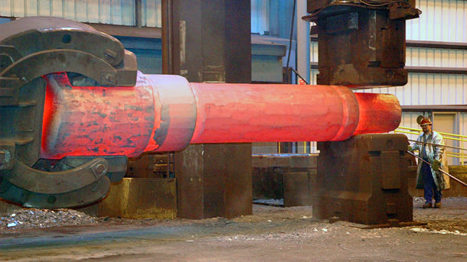
INTRODUCTION
A smithy’s work involves heating of a metal stock to a desired temperature, enable it to obtain sufficient plasticity, followed by the operations like hammering, bending, pressing etc., to give it the desired shape. This is known as forging.
The above operations can either be carried out by hand hammering, by power hammers, or by forging machines..

Slide 3
Forging
Hand forging is the term used for the process when it is done by hand tools. Similarly, forging done with the help of power hammers is known as power forging, when carried out by means of drop hammers as drop forging, and when by forging machines as machine forging.
Applying pressure for shaping the metal, the primary requirement always is to heat the metal to a definite temperature to bring in into the plastic state.
This may be done either in an open hearth, known as smith’s forge, or in closed furnace. Small jobs are normally heated in the Smith’s forge and larger jobs in closed furnaces.
The Hand forging process is employed for relatively small components, machine forging for medium sized and large articles requiring very heavy blows and drop forging for mass production of identical parts.

Slide 4
Smith’s forge or hearth
It has a robust cast iron or steel structure consisting of 4 leg supports, an iron bottom known as hearth, a hood at the top and tuyere opening into the hearth either from the rear or from the bottom.
The hearth carries the coal and provided with fire bricks lining to withstand the extensive heat produced due to the combustion of coal.
In the absence of this lining the heat produced, as started above, will directly effect the metal structure of the hearth, so that the body, particularly the bottom and the surrounding walls, may even melt.
With the result, the entire structure will collapse and the hearth will no more be useful.

Slide 5
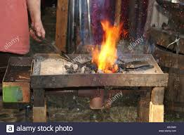
Hearth
Air, under pressure is supplied by the blower, suitably placed somewhere near the forge, through the tuyere opening in the hearth.
This blower can either be hand operated or power driven. The latter is preferable, but in the absence of availability of power supply choice of the former has no alternative.
If hand blowers are to be used, they are usually mounted at the rear of the forge itself. In case the power driven units are to be employed the blower is suitably placed in one corner of the shop and all the forges are connected with it by means of a well-laid pipe running underground all around the hearths.

Slide 6
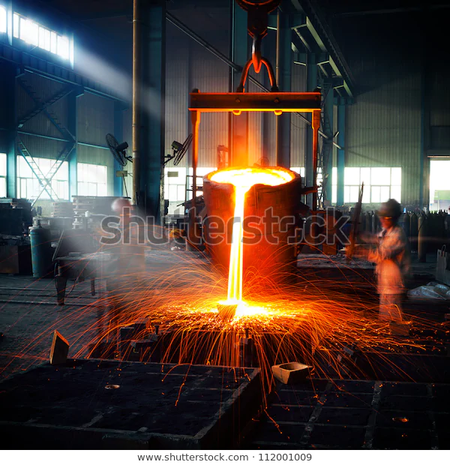
Hearth
At suitable points auxiliary pipes are used to connect the tuyere with the main pipe line.
A valve is incorporated in the auxiliary pipe, just before the place where it is connected with the tuyere, to control the supply of air to the furnace.
The chimney provided at the top enables as easy escape of smoke and gases produced due to the burning of coal.
A water tank is provided, in front of the forge, which carries water for the purpose of quenching.
These hearths can also be made to have masonry construction provided with all the attachments like chimney, tuyere, blower, water tank, etc.

Slide 7
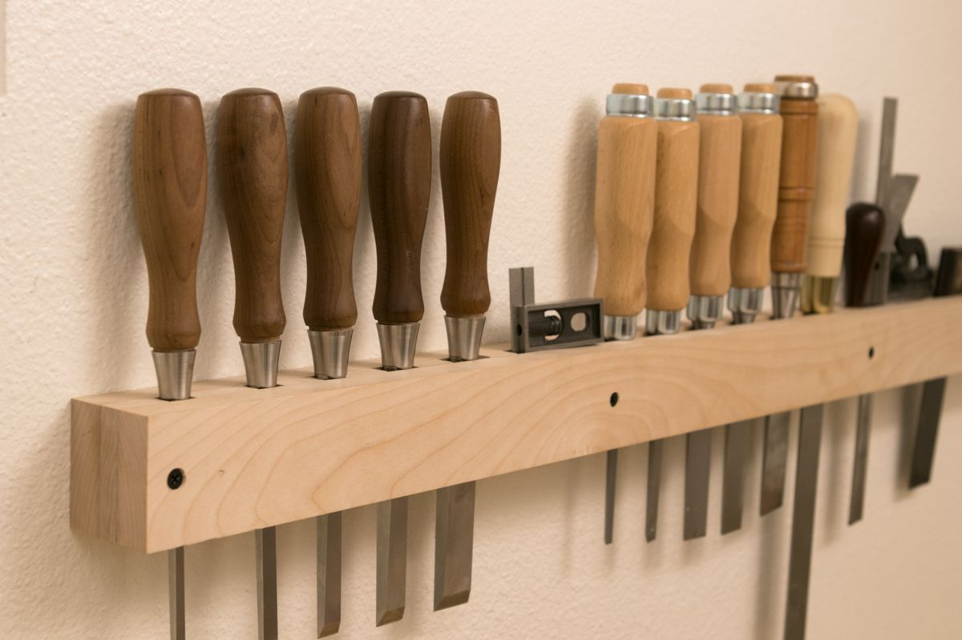
AIM
To make a chisel of given size from a given rod by hand forging
APPLICATION
Chisels are special kinds of cutting tools that widely used to
sharpen, shape, re-shape and carve hard materials like metal,
stone or wood.
SUPPLIED MATERIAL SPECIFICATION
Mild steel rod of diameter 16mm and length 300 mm

Slide 8
TOOLS REQUIRED
1. Caliper and Steel rule
2. Anvil
3. Bold header
4.Tongs
5.Sledge hammer
6. Bottom swage
7. Hand hammer
8.Smoother
9.Hot chisel

Slide 9
SEQUENCE OF OPERATIONS
I. Preparing
II. Upsetting
III. Swaging
IV. Finishing
V. Checking

Slide 10
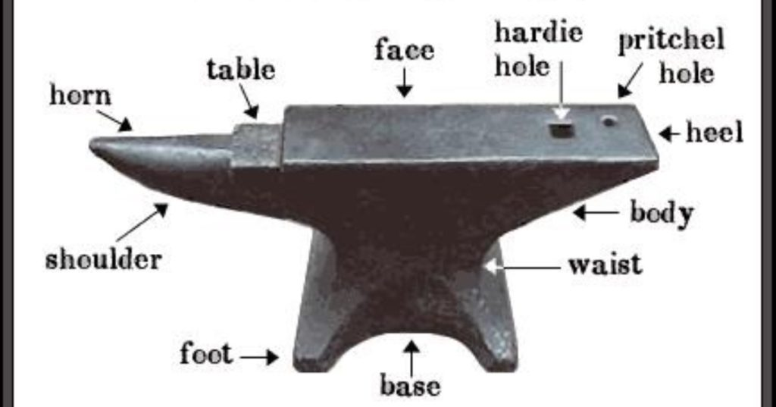
Anvil or Bench plate
To carry out the forging operations successfully, a proper supporting device is needed which should be capable of withstanding heavy blows rendered to the job.
An anvil stands as the most appropriate choice for this purpose.
Its body is generally made of cast steel, wrought iron or mild steel provided with a hardened top, about 20 to 25 mm thick.
This hardened plate is welded to the body on the top.

Slide 11
Anvil
The horn or beak is used in bending the metal or forming curved shapes. The flat step provided, between the top and the horn, is used to support jobs during cutting and is known as chipping block.
The flat projecting piece at the back of the anvil is known as tail.
It carries a square hole to accommodate the square shank of the bottom part of various hand tools like swages, fuller. It is called a hardie hole.
The circular hole provided near the hardie hole is known as pritchel hole.
The commonly used size of an anvil weighs approximately 50-150 kg although it is manufactured in various sizes.
The top face of the anvil should stand at about 0.75 m from the floor.

Slide 12
Hammer
The classification of hammers is largely according to the size and weight of the hammers used in forging.
A smith’s hand hammer is a small sized hammer used by the smith himself and the sledge hammer is comparatively larger in size, heavier in weight and is used by the smith’s helper, known as hammer man.
The smith’s hand hammer is normally a small sized ball peen hammer.
A smith’s hammer is usually a ball peen hammer or a straight peen sledge type hammer of relatively small size. Its weight normally varies between 1.0 kg and1.8 kg

Slide 13
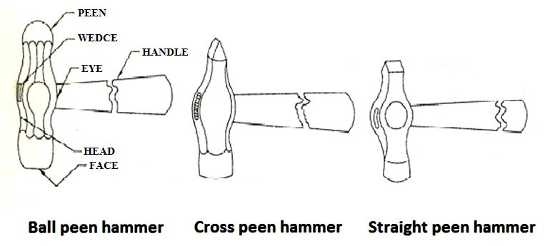
Hammer
A ball peen hammer is used for all general work and its peen is employed when light blows at a faster speed are needed, such as in fullering a rivet head in a countersunk hole.
Sledge hammers are comparatively 3to 4 times heavier than the hand hammers. They are available in varying sizes and weights from 3 kg to 8 kg.
They are employed when heavy blows are needed in forging and other operations done on heavy jobs.

Slide 14
Swage block
It is usually a block of cast steel or cast iron carrying a number of slots of different shapes and sizes along its four side faces and through holes from its top face to bottom face.
This is used as a support in punching holes and forming different shapes.
The job to be given a desired shape is kept on a similar shaped slot, which acts as a bottom swage, and then the top swage is applied on the other side of the job.

Slide 15
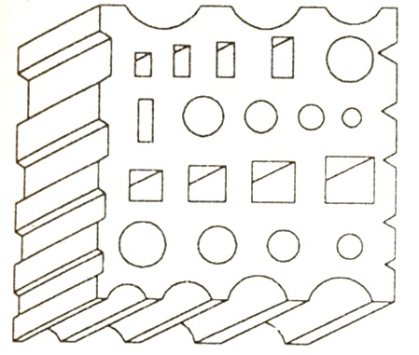
Swage block
The holes in the top and bottom face are used in punching.
Their use prevents the punch from spoiling by striking against a hard surface after the hole

Slide 16
Tongs
They are used to hold the jobs in position and turning over during forging operation. They are made of mild steel.
Tongs are usually made in two pieces, riveted together to form a hinge. Smaller length on one side of the hinge carries the holding jaws, which are made in different shapes and sizes to suit the corresponding shapes and sizes of the jobs, and the longer portions on the other side of the hinge form the arms which are held in hand by the smith.
Overall sizes of the tongs vary according to the size and shape of the job to be held, but the commonly used lengths of the tongs in hand forging vary from 400 mm to 600 mm with the jaws’ opening ranging from 6mm to 55 mm.
Tongs are usually named after the inside shapes of the jaws.
Flat tongs are used for gripping thin section and small flat pieces

Slide 17
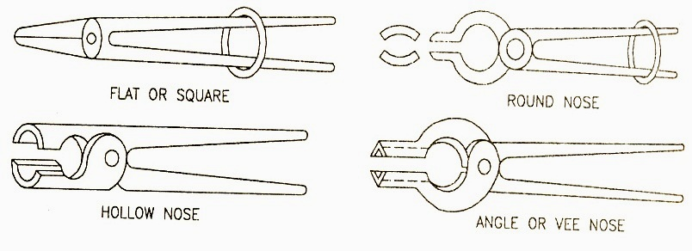
Tongs
Round hollow tongs, with curved surface inside, are used for holding round work.
Hollow tongs with square jaws are used to hold square or hexagonal work.
Pick up tongs have their jaws so shaped that even small sections can be easily picked up. They are not used for holding the work.

Slide 18
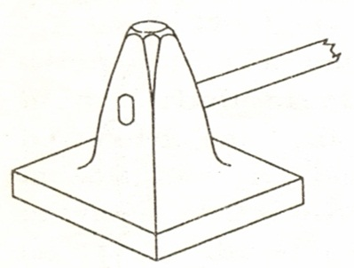
Flatters
These are also known as smoothers.They are made of high carbon steel and consist of a square body, fitted with a handle, and a flat square bottom.
They are used for leveling and finishing a flat surface after drawing out or any other forging operation.

Slide 19
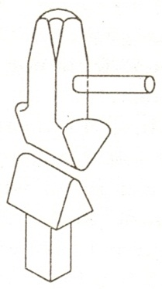
Fullers
T
These tools are made of high carbon steel in different sizes to suit the various types of jobs.
They are usually used in pairs, consisting of a top and a bottom filler. Their working edges are normally rounded.
They, are employed for making necks by reducing the cross-section of a job and also in drawing out.

Slide 20
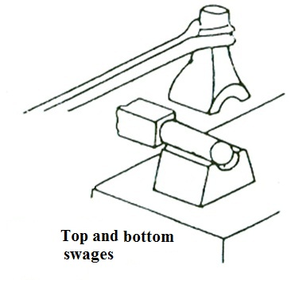
swages
Like fullers, they are also made of high carbon steel in two parts called the top and bottom swages.
Their working faces carry circular grooves to suit the size of the work. They are available in various sizes.
The top swage carries is a handle and the bottom swage a square shank to fit the hardie hole of the anvil during the operation.
They are used for increasing the length of a circularrod or for finishing the circular surface of a job after forging.

Slide 21
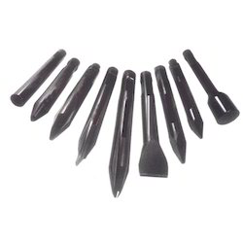
Chisels
Chisels are used to cut metals in hot or cold state.
Those which are used for cutting the metal in hot state are termed as hot chisels and the others used for cutting in cold state are known as cold chisels.
The main difference between these chisels is in the included angle at the cutting edge.
A cold chisel carries an included angle of 600 at the cutting edge and the latter is well hardened and tempered. It is made of high carbon steel.
A hot chisel can be made of medium carbon steel as there is no need of hardening. It is used to cut the metal in plastic state. The included angle of its cutting edge is 300.

Slide 22
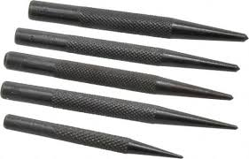
Punches
Punches are tapered tools made in various shapes and sizes.
They are used for producing holes in red hot jobs. A larger tapered punch is called a drift.
The job is placed on the anvil and the punch is hammered through it up to about half its depth.
In is then turned over and the punch made to pass through it.Completion of this operation in two stages prevents the job from splitting and full to bursting.

Slide 23
FOR EXAMPLE : will see how to make Hexagonal head bolt
TOOLS REQUIRED
1. Caliper and Steel rule
2. Anvil
3. Bold header
4.Tongs
5.Sledge hammer
6. Bottom swage
7. Hand hammer
8. Smoother
9. Hot chisel

Slide 24
WORKING STEPS- I. Preparing
1. Take a given work piece and check the given dimensions as per requirements using steelrule and caliper.
2. Place the work piece in hearth / forge until it becomes red hot. (Heating the work pieceeases the process of upsetting)
3. Take the hot stock out of forge, place it on anvil, measure 280mm from one end of stockusing steel rule and cut off with hot chisel.

Slide 25
II. Upsetting
1. Again heat one end of the stock to a length of 90mm.
2. Grip the hot stock with tongs, Place it vertically on anvil such that the hot portion is at
bottom. Strike the top portion with sledge hammer. This will cause increase in diameter of the bottom portion. Keep upsetting until the edge portion becomes slightly larger than the required size of the head.
3. Fix a bolt header over anvil inline with hardie hole in anvil. Upset the head of the bolt with hand hammer.
4. Withdraw bolt from bolt header and with hand hammer round the bolt head on anvil face.This is called as Fullering

Slide 26
III. Swaging
1. Heat the bolt head in hearth again.
2. Insert bottom swage of required hexagonal bolt head dimension in hardie hole of anvil.
3. Remove bolt from forge; place the head on the bottom swage.
4. Strike with hand hammer to give required shape to the head.
5. Turn the head by 60 degree abollt its axis and repeat the step4. Repeat this for all six sides
of the hexagon.

Slide 27
IV Finishing & V. Checking
1. Insert the shank of bolt in bolt header, place stock on anvil so that its shank passes through hardie hole in anvil.
2. Place smoother on bolt head and make top portion of head spherical in shape by striking the smoother with hand hammer
3. Straighten the shank ofthe bolt by placing it on the face ofthe anvil.
V. Checking
1. Check the length of the shank. If it is more than 200mm long, heat the end and cut offsurplus with hot chisel.

Slide 28
RESULT
Thus the required Hexagonal Head Bolt is made out of the given stock.

